Slide 1
Multiple Data Types (2주차)
Young-Gon Kim
DLI Instructor

Slide 2
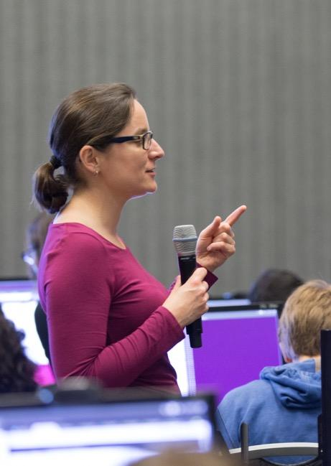
DEEP LEARNING INSTITUTE
DLI Mission
Helping people solve challenging problems using AI and deep learning.
Developers, data scientists and engineers
Self-driving cars, healthcare and robotics
Training, optimizing, and deploying deep neural networks
Notes:
People = Developers, Data Scientist, Engineers
Problems = Self-driving cars, healthcare issues like cancer detection, consumer services and robotics
AI / Deep Learning = training, optimizing and deploying deep neural networks

Slide 3
Week 1 Review
Recurrent Neural Network
TOPICS

Slide 4
WEEK 1 REVIEW

Slide 5
What’s the problem in Week 1?
Notes:
- Week 1 실습에서 문제가 무엇인가???

Slide 6
RECURRENT NEURAL NETWORK (RNN)

Slide 7
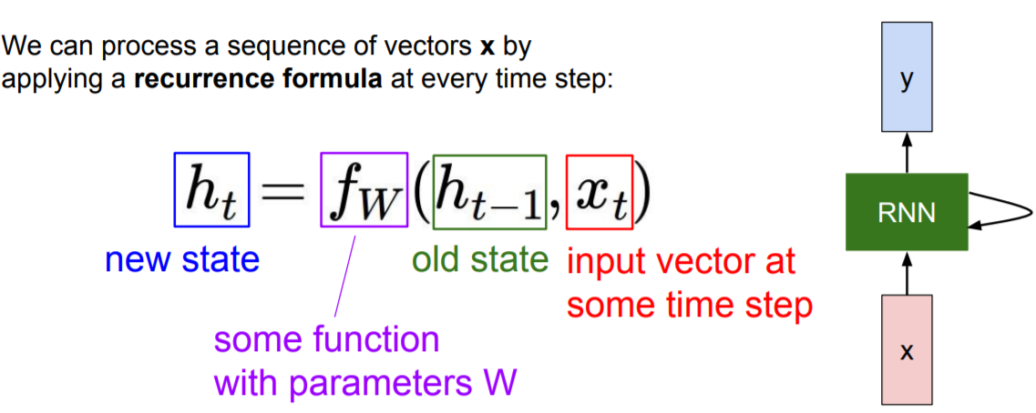
RECURRENT NEURAL NETWORK (RNN)
Architecture
http://cs231n.stanford.edu/slides/2019/cs231n_2019_lecture10.pdf
Notes:
각 cell마다 계산된 state를 다음 cell로 전달 → 이전 정보를 유지하며 진행

Slide 8
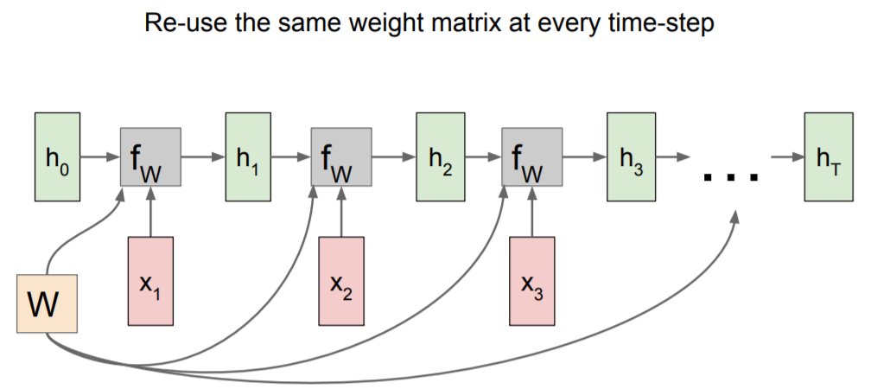
RECURRENT NEURAL NETWORK (RNN)
Architecture
http://cs231n.stanford.edu/slides/2019/cs231n_2019_lecture10.pdf
Notes:
모든 state에 같은 weight가 적용됨

Slide 9
RECURRENT NEURAL NETWORK (RNN)
Architecture
a | the | on | is | cat | park | play | swing | grass | sitting
0 | 1 | 2 | 3 | 4 | 5 | 6 | 7 | 8 | 9
x(t-1)
x(t)
x(t+1)
[ 0 , 4 , 3 , 2 , 1 , 8 ]
U
U
U
A cat is on the grass.
W
W
W
s(t-1)
s(t)
s(t+1)
RNNs learn by reducing the error between their predicted next word and the actual next word in a corpus. RNNs are structured to "remember" the words that led to their prediction.
V
V
V
o(t-1)
o(t)
o(t+1)
Unrolled Recurrent Layer
Notes:
Word를 vectorize하여 예측

Slide 10
RECURRENT NEURAL NETWORK (RNN)
Architecture
One-hot encoding
a
Word prediction example
[1,0,0,0,0,0,0,0,0,0]
Input
a | 1 | 0 | 0 | 0 | 0 | 0 | 0 | 0 | 0 | 0
cat | 0 | 0 | 0 | 0 | 1 | 0 | 0 | 0 | 0 | 0
is | 0 | 0 | 0 | 1 | 0 | 0 | 0 | 0 | 0 | 0
on | 0 | 0 | 1 | 0 | 0 | 0 | 0 | 0 | 0 | 0
the | 0 | 1 | 0 | 0 | 0 | 0 | 0 | 0 | 0 | 0
grass | 0 | 0 | 0 | 0 | 0 | 0 | 0 | 0 | 1 | 0
W
Recurrent layer
h(t)
Output
[0,0,0,0,1,0,0,0,0,0]
cat
Notes:
Vector들을 one-hot encoding하여 binary classification으로 바꿈

Slide 11
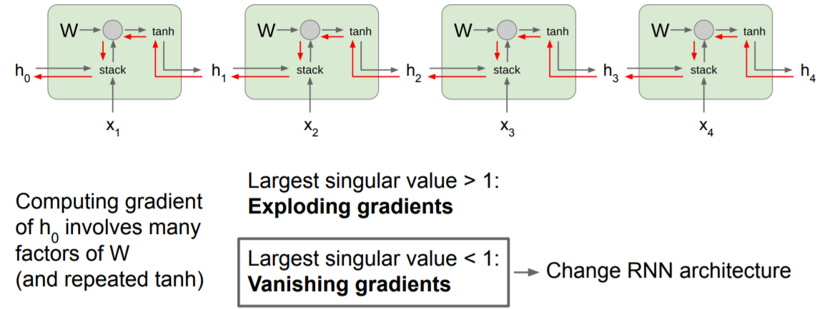
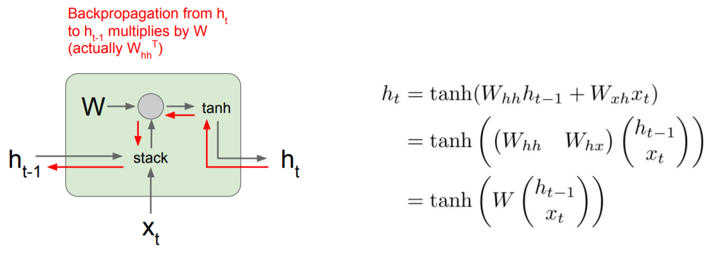
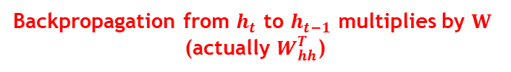
RECURRENT NEURAL NETWORK (RNN)
Architecture
Vanilla RNN
Input과 hidden state에 matrix연산 진행
Vanishing gradient
Backpropagation from $h_{t}$ to $h_{t−1}$ multiplies by $W$ (actually $W_{hh}^{T}$)
http://cs231n.stanford.edu/slides/2019/cs231n_2019_lecture10.pdf
Notes:
Input과 hidden state에 각각 matrix 연산 진행
계산된 hidden state를 다음 cell로 전달
깊이가 깊어지면 vanishing gradient 발생

Slide 12
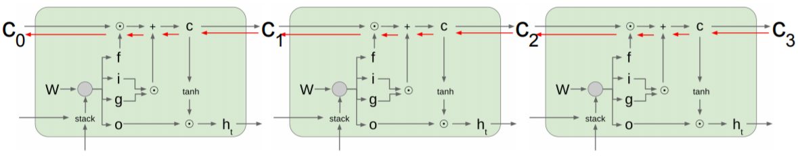
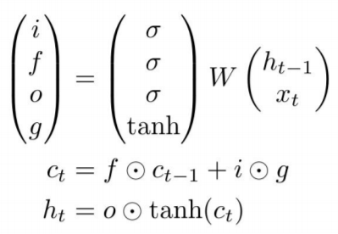
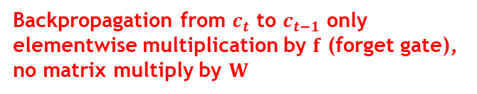
RECURRENT NEURAL NETWORK (RNN)
Architecture
Long Short Term Memory (LSTM)
Cell state를 통해 RNN의 vanishing gradient 해결
forget gate, input gate로 성능 향상
Backpropagation from $c_{t}$ to $c_{t−1}$ only elementwise multiplication by $f$ (forget gate), no matrix multiply by $W$
Uninterrupted gradient flow!
http://cs231n.stanford.edu/slides/2019/cs231n_2019_lecture10.pdf
https://ratsgo.github.io/natural%20language%20processing/2017/03/09/rnnlstm/
Notes:
RNN에서 문제가 되었던 vanishing gradient를 cell state를 추가하여 해결
forget gate, input gate로 성능 향상

Slide 13
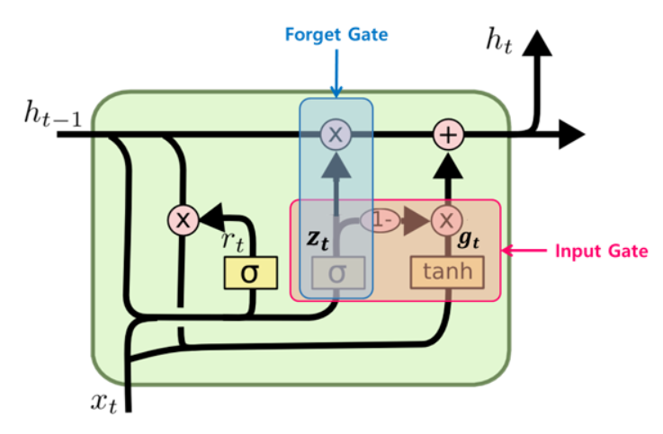
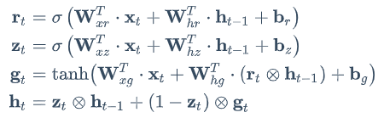
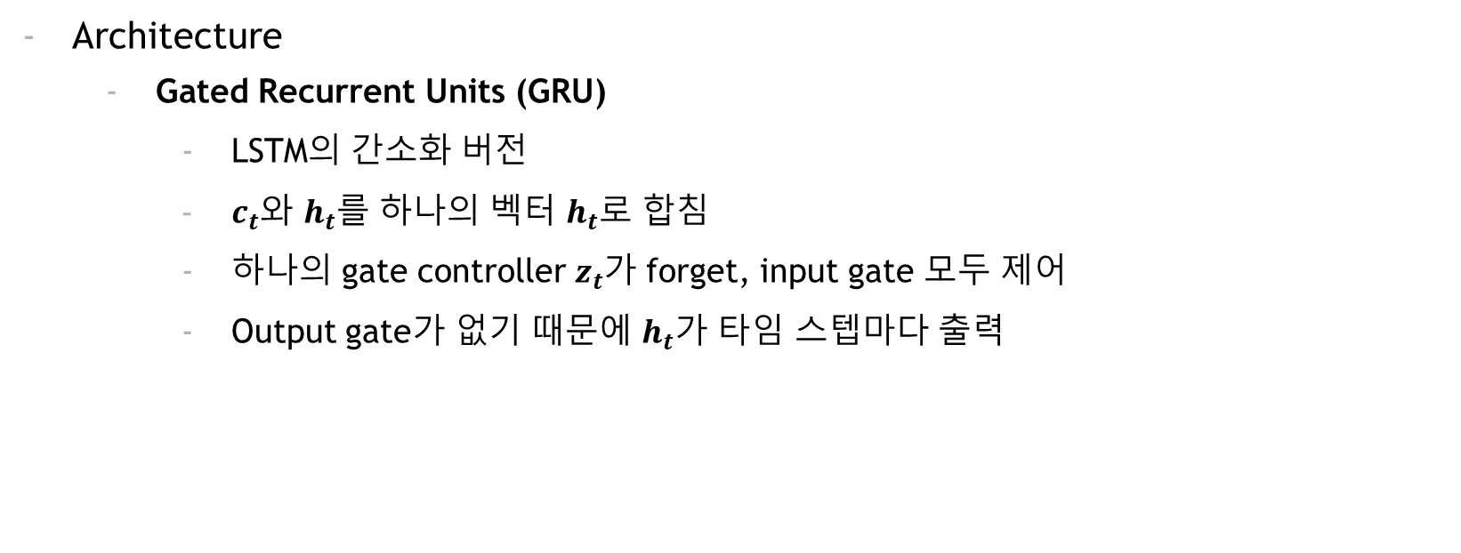
RECURRENT NEURAL NETWORK (RNN)
Architecture
Gated Recurrent Units (GRU)
LSTM의 간소화 버전
$c_{t}$와 $h_{t}$를 하나의 벡터 $h_{t}$로 합침
하나의 gate controller $z_{t}$가 forget, input gate 모두 제어
Output gate가 없기 때문에 $h_{t}$가 타임 스텝마다 출력
https://excelsior-cjh.tistory.com/185
Notes:
LSTM의 간소화 버전
$c_{t}$와 $h_{t}$를 하나의 벡터 $h_{t}$로 합침
하나의 gate controller $z_{t}$가 forget, input gate 모두 제어
Output gate가 없기 때문에 $h_{t}$가 타임 스텝마다 출력

Slide 14
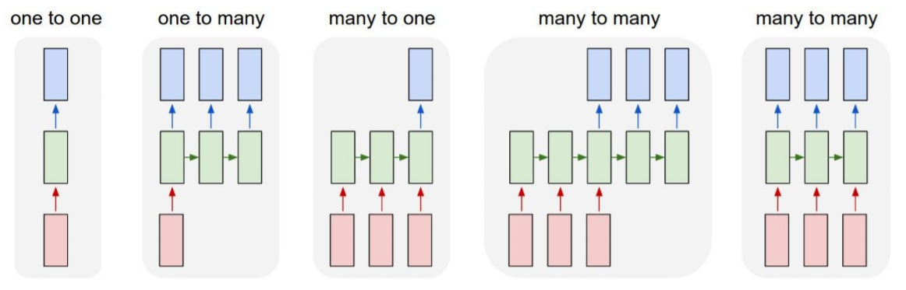
RECURRENT NEURAL NETWORK (RNN)
Application
Vanilla Neural Networks
Image Captioning
(image → sequence of words)
Sentiment Classification
(sequence of words → sentiment)
Machine Translation
(seq of words → seq of words)
Video Classification on Frame Level
http://cs231n.stanford.edu/slides/2019/cs231n_2019_lecture10.pdf

Slide 15
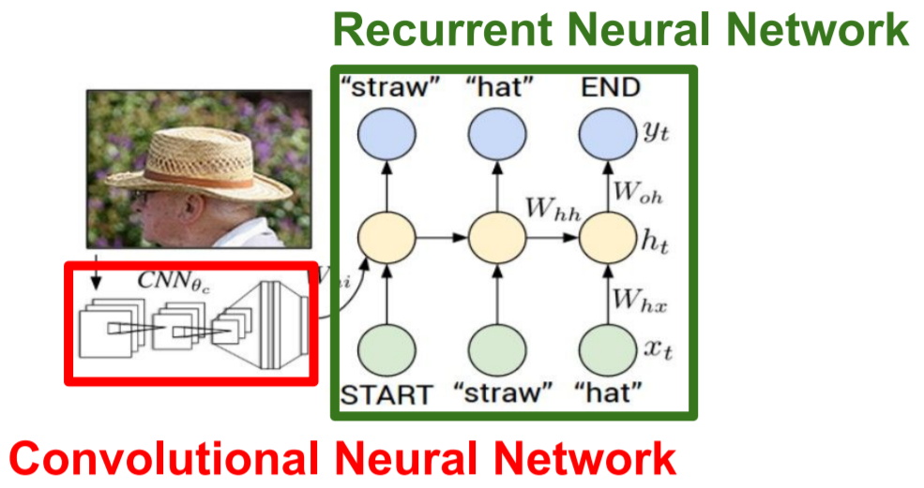
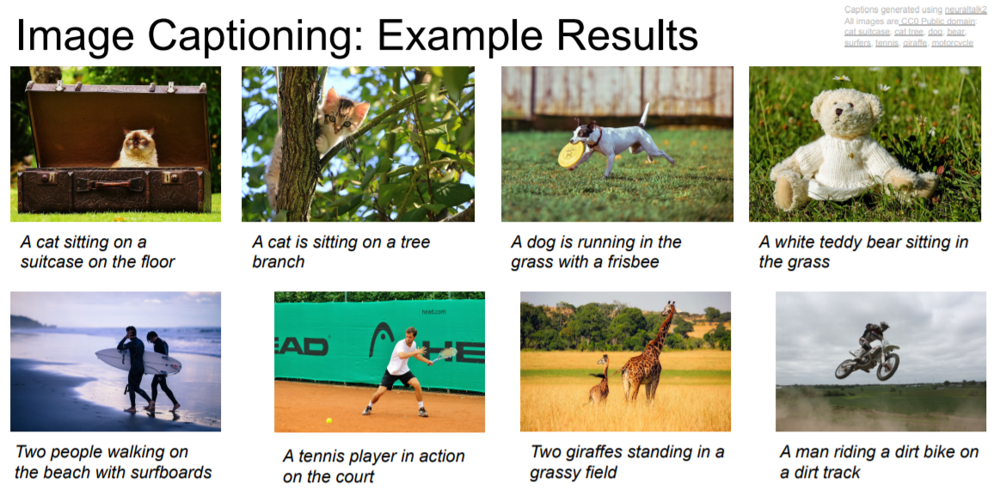
RECURRENT NEURAL NETWORK (RNN)
Application
Image Captioning
해당 Image를 설명하는 언어로 변환
http://cs231n.stanford.edu/slides/2019/cs231n_2019_lecture10.pdf

Slide 16
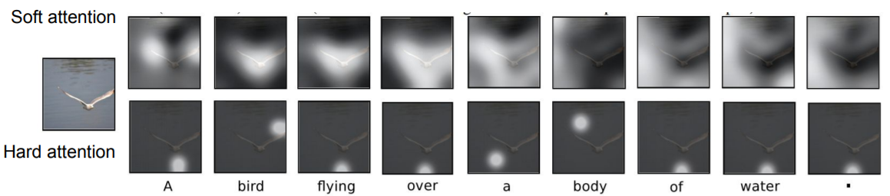
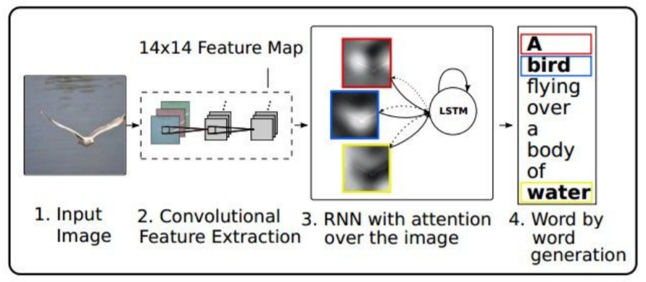
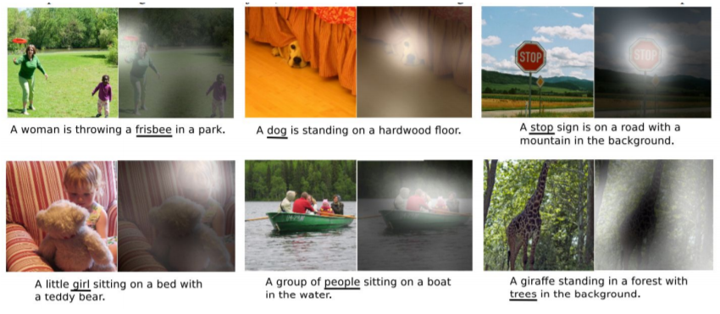
RECURRENT NEURAL NETWORK (RNN)
Application
Image Captioning
with Attention
http://cs231n.stanford.edu/slides/2019/cs231n_2019_lecture10.pdf
Notes:
각 단어가 어느 부분에 attention 되는지 확인도 가능

Slide 17
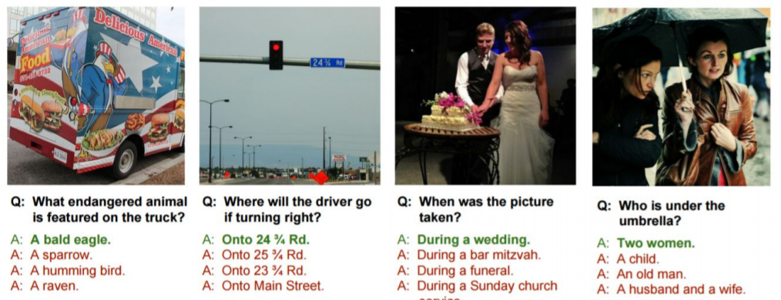
RECURRENT NEURAL NETWORK (RNN)
Application
Visual Question Answering
http://cs231n.stanford.edu/slides/2019/cs231n_2019_lecture10.pdf

Slide 18
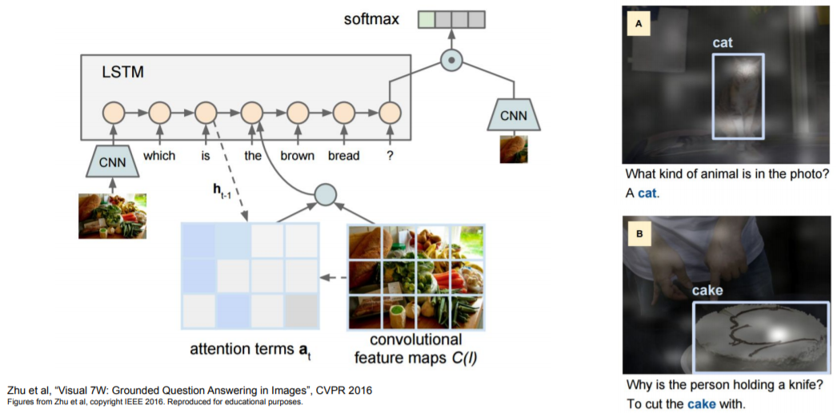
RECURRENT NEURAL NETWORK (RNN)
Application
Visual Question Answering
RNNs with Attention
http://cs231n.stanford.edu/slides/2019/cs231n_2019_lecture10.pdf

Slide 19

RECURRENT NEURAL NETWORK (RNN)
Application (Extra)
Transformer
In NLP, Input을 더 이상 sequential로 처리 X
Attention mechanism
e.g.
BERT (J. Devlin et al., NAACL 2019.)
OpenAI GPT-2 (A. Radford et al., 2019.)
http://cs231n.stanford.edu/slides/2019/cs231n_2019_lecture10.pdf
Attention is all you need : https://arxiv.org/pdf/1706.03762.pdf
BERT : https://arxiv.org/pdf/1810.04805.pdf
GPT-2 : https://cdn.openai.com/better-language-models/language_models_are_unsupervised_multitask_learners.pdf
Notes:
최근 natural language processing에서는 RNN 계열 모델보다 attention으로 구성된 transformer 계열을 많이 사용함

Slide 20
Reference
http://cs231n.stanford.edu/slides/2019/cs231n_2019_lecture10.pdf
https://ratsgo.github.io/natural%20language%20processing/2017/03/09/rnnlstm/
https://excelsior-cjh.tistory.com/185
Attention is all you need : https://arxiv.org/pdf/1706.03762.pdf
BERT : https://arxiv.org/pdf/1810.04805.pdf
GPT-2 : https://cdn.openai.com/better-language-models/language_models_are_unsupervised_multitask_learners.pdf

